Slide 1
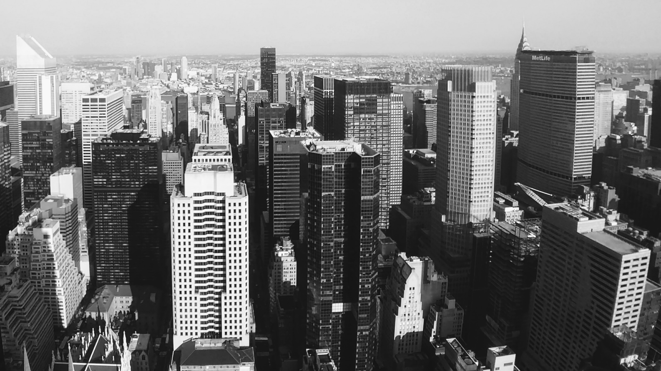
Slide 1
Visualizing Bus Service Frequency
in Pune City
Power Point Presentation By
Tushar Jadhav [ 2020MT93213 ]
Ajay Patil [ 2020MT93265 ]

Slide 2
Slide 6
INTRODUCTION
background
Pune Mahanagar Parivahan Mahamandal Ltd (PMPML) is the public transport bus service provider in Pune city.
Fleet of 1300 buses serves around 11,00,000 passengers each day!
Now there are many private transport options available. But if there is a better public transport network and frequency, then one may consider going by public transport as well.
6

Slide 3
Slide 6
INTRODUCTION
problem
We will try to visualize the bus frequency of some of the busiest bus-stops in Pune city.
We’ve two main resources, first is map of bus routes and second is a timetable of buses on the route.
Map gives us information about what route bus will follow in a geographic context, but it won’t give any information about frequency of buses for a particular bus stop.
Timetable gives us information about bus frequency at a particular bus stop but lacking geographic context.
How about we combine this two information and visualize them!
We will also try to identify or cluster the bus stops according their locality. (commercial / residential zone, developed / under-developed area etc.)
6

Slide 4
Slide 6
INTRODUCTION
interest
Bus transit visualization will give the frequency of buses on particular routes for a particular time period.
Analyze service efficacy, transit performance, traffic management, route spacing, geographical coverage / network of service, cost efficiency and service effectiveness.
This will help city planners to propose the bus stops and route network.
Explore new modes of public transport such as metro, trains as a replacement to fulfil the demand of the growing population of the city.
City planning with the help of modern methods can prevent our economic waste !
6

Slide 5
Slide 6
Data
data sources
The PMPML Data
Open Data initiative of Government of India
Details of dataset
URL : PMC Open Data Store
Dataset title : PMPML Bus Routes - July 2019
Tag/ category : PMPML
File type : .zip
Size : 8.81 MB
There are total 9 text files out of which we are going to use below 5 text files for analysis.
stops, shapes, calendar, trips, stop_times
6

Slide 6
Slide 6
Data
data sources
The Foursquare Data
Foursquare Places API
For Foursquare query we will need following information:
Bus stop location (can be taken from ‘stop.txt’)
Search code of main venue categories to search for.
We can find search codes in below Foursquare documentation.
We’ll query 10 main categories with their search codes for every bus stop.
Search radius (we will search within 1km radius from bus stop location)
6

Slide 7
Slide 6
Data
Feature selection, Data cleaning and validation
There few problems with “stop_times.txt” data
First, arrival and departure times were not in correct 24hr format. For arrival time “23:59:40”, departure time is “24:01:21”, such values are observed when the trip begins late night and ends early in the morning. Ideally here departure time should be “+1 Day 00:01:21”. However, we can use this problem itself as filter to correct the time information as per our requirement.
The second problem with dataset is the difference between arrival and departure time is not realistic. For some bus stops difference is greater than 5 hrs. To solve this issue, we can use 75% occurrence value to replace time differences greater than 3 mins.
The third problem is also similar to second where the difference between the arrival times of two consecutive bus stops is greater than 5 hrs
6

Slide 8
Slide 6
Data
Feature selection, Data cleaning and validation
After preparing and combining the data from all the text files, there were 21803 unique trips with 19 features in the data.
Sr. No. | Resource / File Name | Feature Name
1 | stops.txt | stop_id
2 |  | stop_name
3 |  | stop_lat
4 |  | stop_lon
5 | trips.txt | route_id
6 |  | service_id
7 |  | trip_id
8 |  | trip_headsign
9 |  | direction_id
10 |  | shape_id
Sr. No. | Resource / File Name | Feature Name
11 | stop_times.txt | trip_id
12 |  | arrival_time
13 |  | departure_time
14 |  | stop_id
15 |  | stop_sequence
16 | Derived features | trip_distance
17 |  | trip_duration
18 |  | trip_bgn_time
19 |  | trip_end_time
6

Slide 9
Slide 6
Methodology
For clustering the data on the basis of stop location / venue details
We’ve PMPML’s bus stop data and Foursquare venues data of each bus stop surroundings.
We’ll normalize the data set of Foursquare data and cluster them using the KNN algorithm.
Then we’ll train the model with the best value of clusters and merge the generated cluster labels with our PMPML’s bus-stop dataframe.
For further analysis on how clusters are formed we can plot the 75% values of each venue category for each cluster.
6

Slide 10
Slide 6
Methodology
For Visualizing the bus frequency
We’ve to limit the number of bus-stops for visualization because visualizing all of them at a time may not look useful.
We’ll find out busiest bus-stops on the basis of trip count.
We’ll normalize the trip count data for each bus stop and apply the KNN algorithm to get clusters.
Trips are executed depending on service ID, which is selected depending on day of the week. So, for each day of the week we will have a list of service IDs to run.
We’ll select duration as Friday 02/08/2019 00:00:00 hrs to 03/08/2019 02:00:00 hrs for our analysis. Cont..
6

Slide 11
Slide 6
Methodology
For Visualizing the bus frequency
Now we’ve our dataframe filtered with busiest bus stops and service IDs.
All we’ve to do is repeatedly filter dataframe for every 2 minutes for mentioned duration and map bus location for every trip at given time.
Also, as we map the buses, we’ve to save them into the image format.
Once we’ve all the map images, we can combine them to form GIF for visualization.
6

Slide 12
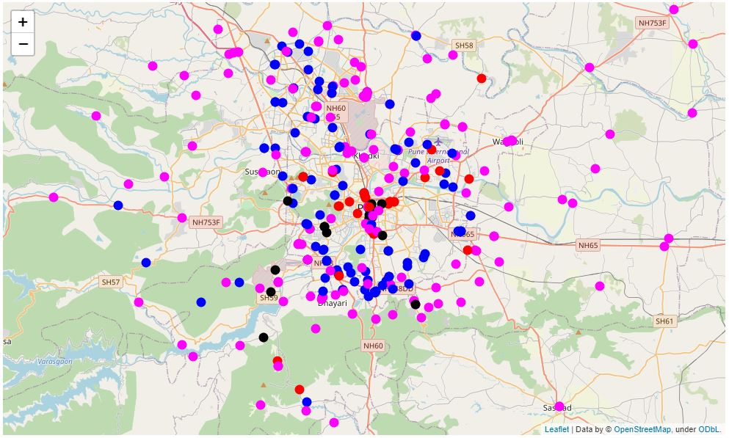
Slide 6
Results & Discussions
Clustering the data on the basis of stop location / venue details
After clustering the bus stops based on Foursquare data, we can get the following map.
6

Slide 13
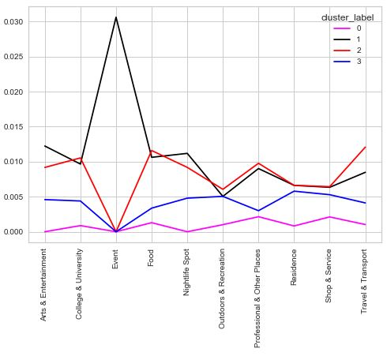
Slide 6
Results & Discussions
Clustering the data on the basis of stop location / venue details
Let’s try to understand clustering from the below line plot.
6

Slide 14
Slide 6
Results & Discussions
Clustering the data on the basis of stop location / venue details
What are cluster 1 & 2?
Cluster 2 contains the highest amount of transport venues compared to any of the clusters.
Cluster 1 is very similar to cluster 2 with the only significant difference in the number of Events venues.
What are cluster 0 & 3?
Cluster 0 has a smaller number of venues compared to any of the other clusters.
Cluster 3 has more venues than cluster 0 but lesser than cluster 1 or 2.
6

Slide 15
Slide 6
Results & Discussions
Clustering the data on the basis of stop location / venue details
So, from the above observation and plot, we can say that:
Cluster 2 is a developed part of the city and contains bus stops that are close to transport venues such as railway / bus / metro stations or airports etc.
Cluster 1 is also a developed part of the city with the highest amount of Event venues.
Cluster 0 is remote / underdeveloped part of the city
Cluster 3 is a developing part of the city.
From the map, we can say that, although clusters 1,2, and 3 have lesser bus stops, they are densely located. This suggests that bus-stops have very good connectivity in the central / old part of the city.
6

Slide 16
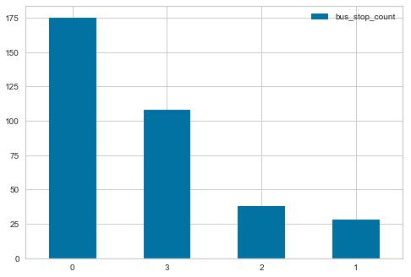
Slide 6
Results & Discussions
Clustering the data on the basis of stop location / venue details
We also plotted the bar chart of the number of bus stops for each cluster.
From the bar chart, we can say that bus service has a great network in for remote parts of the city (cluster 0), then it also covers travel / transport venues with a comparatively (compared to cluster 1) higher number of bus stops (cluster 2).
6

Slide 17
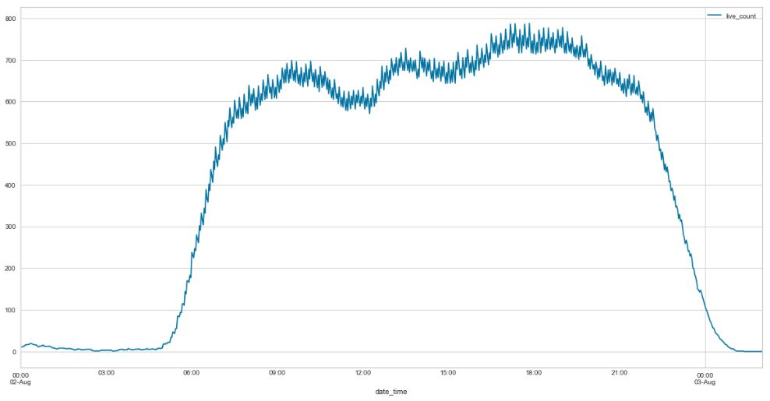
Slide 6
Results & Discussions
Visualizing the bus frequency
We can also plot bus frequency for different times of the day.
6

Slide 18
Slide 6
Results & Discussions
Visualizing the bus frequency
From the plot, we can say that bus frequency rapidly increases around 6 am and touches the morning peak of approx. 660 buses in motion at around 9:30 am. We can call it 'morning rush'.
After the noon bus frequency again increases close to 700 buses in motion and remains there up till 05:00 pm.
Between 05:00 pm to 07:30 pm bus frequency is close to 750 buses in motion, we can call it as 'evening rush'.
From 07:30 pm onwards frequency declines gradually till 10:00 pm, and after that, it takes a plunge.
6

Slide 19
Slide 6
Results & Discussions
Visualizing the bus frequency
Now, we've images/frames that can be used to make GIF.
There are approx. 819 images/frames (size: 339 MB), since combining these images to form a GIF will require a lot of memory, I've used 'PhotoScape X' software (for Windows 10) to make final GIF.
Software settings are:
Frame rate: 20 frames/sec
Frame size: 500 x 251 px
Loop: Infinite
6

Slide 20
Slide 6
Results & Discussions
Visualizing the bus frequency
Final GIF
6

Slide 21
Slide 6
Results & Discussions
Visualizing the bus frequency
From the GIF visualization we can conclude on the following points:
There are approx. 7 roads that are used by bus trips to connect / pass through the central part of the city.
Bus frequency is fairly similar on every bus stop on these 7 main roads of the city for any given period.
We can observe comparatively high traffic in the central part of the city from 7:30 am to 10:30 pm
6

Slide 22
Slide 6
Conclusion
Location data is continuously growing so we have to find new ways to visualize this information and it must be clearer and more intuitive.
In this project, we tried this new approach to visualize the bus frequency in Pune city.
We can study individual bus stops and their pattern for more details.
However, this data will be more effective if we can analyse it with community mobility data.
It can give more insights into how people move during a different time and in different parts of the city.
We can have a comparison with current transit options and improve or if required implement new transit modes.
6

Slide 23

Slide 11
THANK YOU

